Slide 1

Understanding Key Qualities in Airbnb’s Edinburgh listings to Identify Potential Price Trends
Capstone Project 3rd December, 2020
Fraser Stark

Slide 2

Presentation Agenda
1.Business Question
4.Analysis
2.Methodology
5.Results
3.EDA and Results
6.Summary, Conclusion and Further Steps

Slide 3

Business Question
"Is it possible to identify which qualities and trends within Airbnb listings have the biggest influence on their price?"

Slide 4

The Data
Data set taken from InsideAirbnb
Raw Data set, initially 6557 rows 74 columns
Null Values, both present, in full columns and sporadic rows
Irrelevant columns and strong outliers removed
Null Values addressed within Data set
Data set then condensed to relevant information
Once cleaned, Data set contained 6435 rows and 64 columns

Slide 5

The Methodology
Key Variable Selection
Machine Learning
Evaluate and Conclude
Import,
cleaned Airbnb data
Commit to EDA

Slide 6

Analysis
Folium Map of Edinburgh with The Top 100 Airbnb Sites

Slide 7

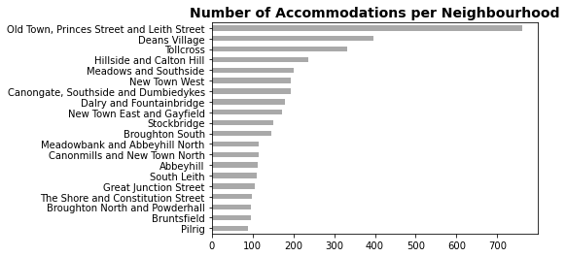
Analysis - How Much?
Large number of accommodation sites situated in older parts of Edinburgh, largely frequented with tourists. Lesser numbers in The New Town and more residential areas.

Slide 8

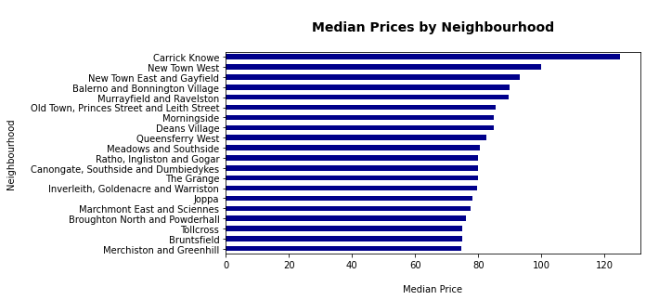
Analysis – How Much?
Most expensive areas associated with scenic locations within Edinburgh, inclusive of Old Town. This again suggest that Airbnb sites are geared towards the tourist market.

Slide 9

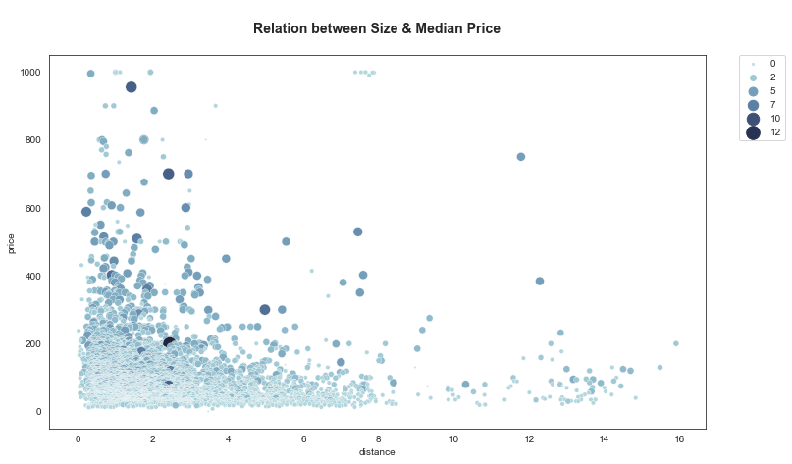
Analysis – Size and Price
Graph showing relationship between distance from Edinburgh centre, in relation to Price and number of rooms. Price point does not necessarily change the further out you stay.

Slide 10

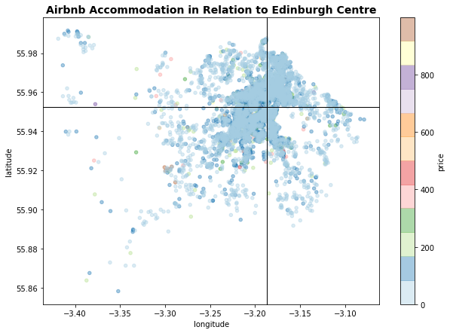
Analysis - Price and Geography
Intersection of black lines depicts the centre of Edinburgh.
Intense build up of properties around inner Edinburgh
Greater Edinburgh has lesser properties, however, heatmap suggest little fluctuation in price.

Slide 11

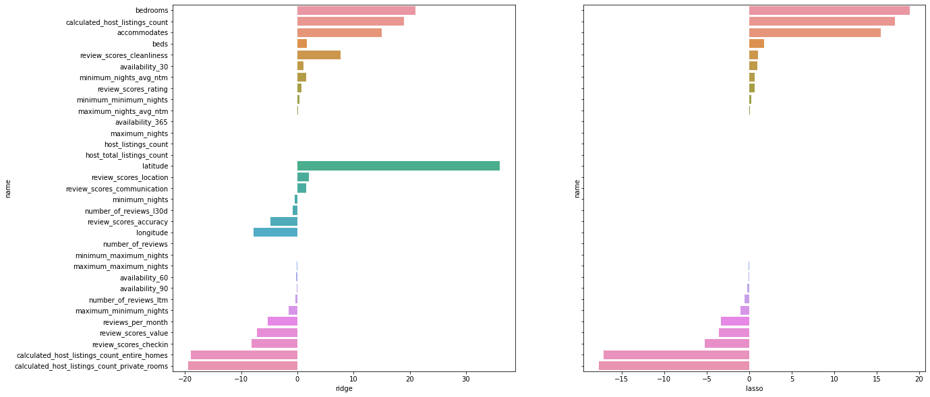
Results – Lasso and Ridge
Bedrooms seems to be a significant quality in deciding price trends in Airbnb in Edinburgh

Slide 12

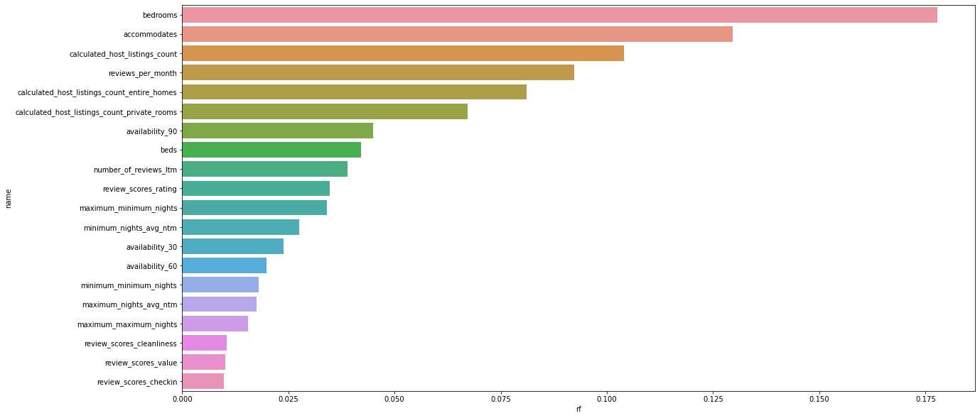
Results – Random Forest

Slide 13

Analysis
The Qualities and Trends:
Numbers of bedrooms and how many people the property can accommodate.
How many listings the host has online at any one time.
How often the sites have been reviewed over the month.
Whether these sites are dedicated homes or private rooms.
The availability of the accommodation over a 90 day window.
Potential Applications:
Pricing calculator to help prospective hosts price their accommodation correctly.
Knowing market trends could allow Airbnb staff to advise hosts of under or over-priced properties.
Communicate with hosts before peak times advising them of recommended pricing during busy seasons.
Continue to compare this data to competitors to ensure pricing remains fair and competitive.
14

Slide 14

Next Steps
Airbnb and/or Airbnb Host
Business Question
Business Answer
Data Question
Data
Answer
Data Analysis
Feature Selection
Modeling and Validation
SOLUTION
This is important because we can use this data to ensure Airbnb listings in Edinburgh are priced fairly and competitively, keeping Airbnb a relevant supplier of tourist accommodation.

Slide 15

Summary and Conclusion
Data
External Considerations
Outcomes
With further investigation of categorical data, it is possible that further trends could be identified at are associated with price point of an Airbnb eg Amenities.
Date data, in relation to the tourist season, associated with The Edinburgh Tattoo and Comedy Festival/Fringe/Arts Festivals would help establish any potential peak an off-peak price differences.
Outside of merely what the data states, consideration could be placed on the following:
Quality of Airbnb adverts
Hosts Communication Skills
Physical Amenities
Dates during which accommodation is available
Relationship between no of Bedrooms and the sites ability to accommodate proven.
Sites continually available to be occupied over a 90 day window tend to be an indicator of a better price point.
Higher reviewed sites tend to command a better price point.
Distance is not a major contributing factor.

Slide 16

THANK YOU
Do you have any questions?

